Slide 1

SegNet: A Deep Convolutional Encoder-Decoder Architecture for Image Segmentation
Vijay Badrinarayanan, Alex Kendall, Roberto Cipolla
IEEE Transactions on Pattern Analysis and Machine Intelligence, 2016
Davide Bartoletti S296091
Domenico Bulfamante S301780
Giovanni Sciortino S302959
MLDL A.A 2021/2022

Slide 2
Introduction
Paper Presentation

Slide 3
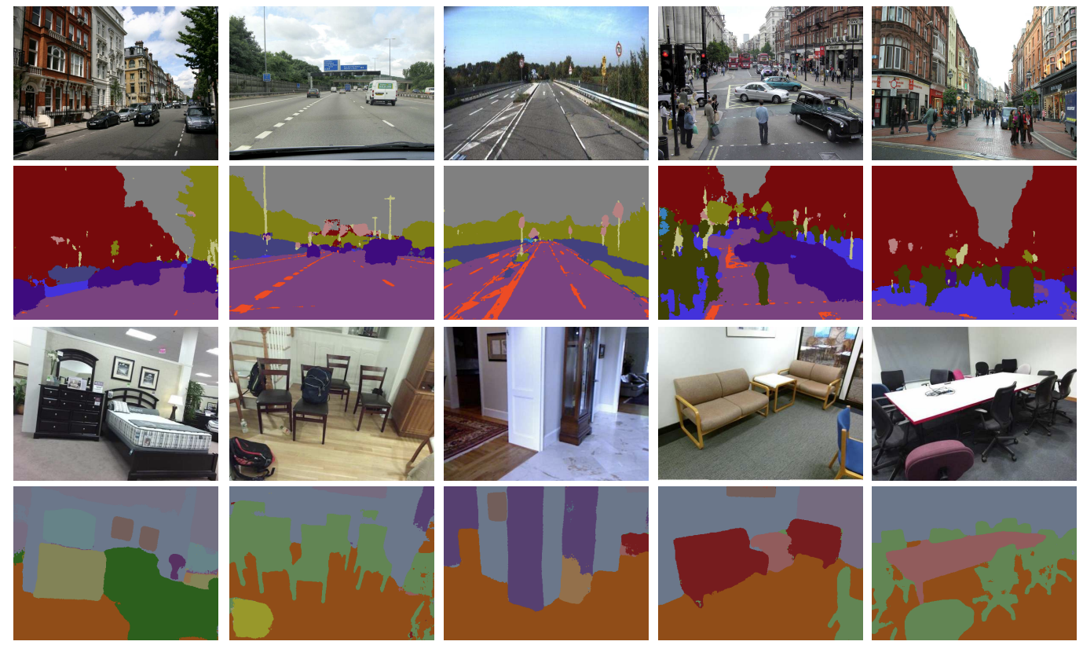
Semantic Segmentation:
Process of linking each pixel in an image to a class label according with specific categories.
SegNet predictions on road scenes and indoor scenes

Slide 4
SegNet
Deep fully convolutional neural network architecture
Encoder Network : VGG16 with no fully connected layers
Decoder Network : from low resolution features maps to full resolution features maps
Trade off between memory and accuracy
Max-pooling Indices

Slide 5
Related Works
Previous architectures for semantic segmentation

Slide 6

Literature Review
Evolution of the methods implied for semantic segmentation:
Hand engineered features
Classifier techniques
Object categorization to segmentation
Deep convolutional network
Newer deep architecture
Decode low resolution image representation to pixel-wise predictions

Slide 7
Architecture
Network components and their behaviour

Slide 8
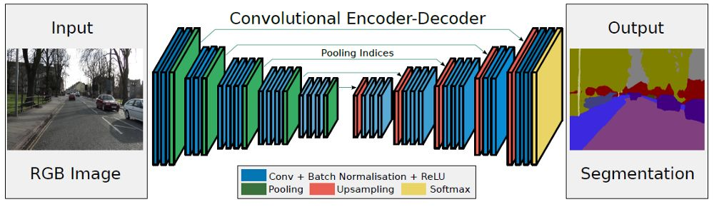
Architecture
ENCODER
DECODER
13 convolutional layers

Slide 9
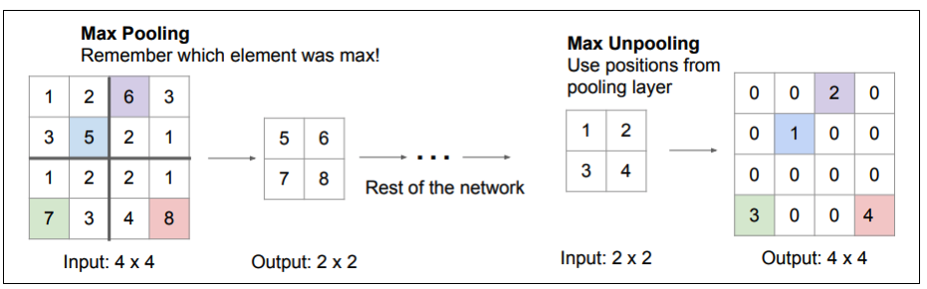
Why the usage of max-indices in the decoder phase?
Improves boundary delineation
Reduces the number of parameters enabling end-to-end training
This form of upsampling can be incorporated into any encoder-decoder architecture

Slide 10
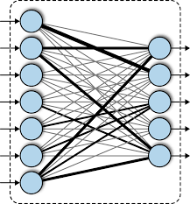
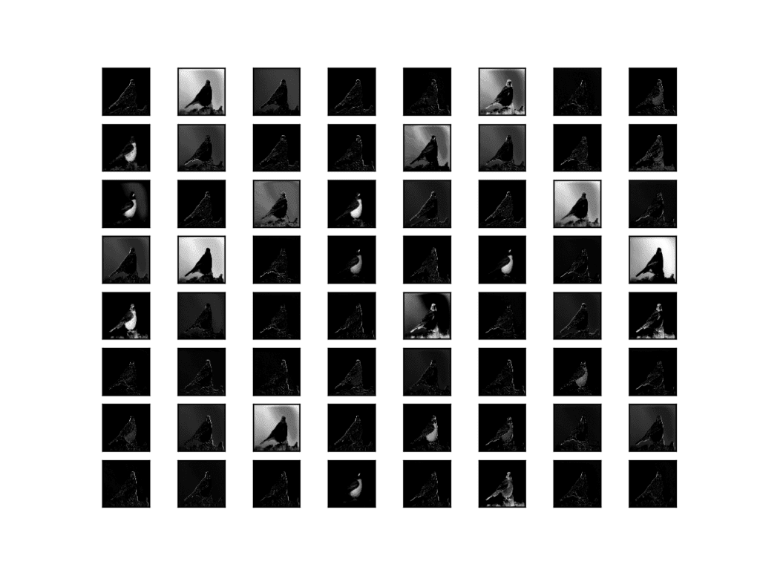
Two similar architectures:
DeconvNet:
Larger parameterization and computational resources
Usage of fully connected layers
U-Net:
No reuse of pooling indices
Transfering of the entire feature map to the decoders
DECODER
Structure of fully connected layers
The full feature map is passed to the decoder

Slide 11
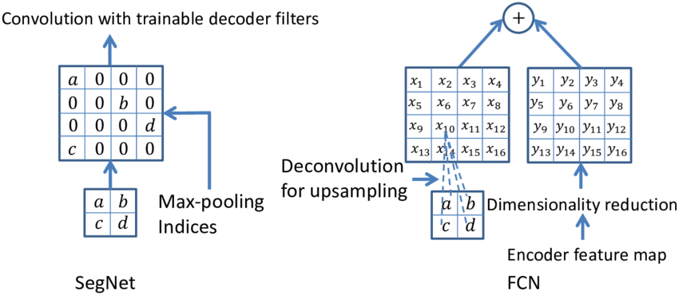
SegNet vs Fully Convolutional Network

Slide 12

Training
CamVid road scenes
Benchmark performance
Local contrast normalization
Local subtraction and division normalizations
Stochastic gradient descent
<
Learning rate : 0.1
Momentum : 0.9
Class balancing

Slide 13
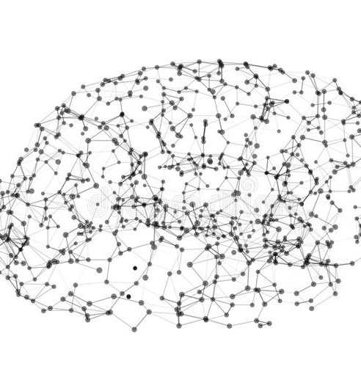
Analysis
Global accuracy
Class average accuracy
Mean intersection over union – mIoU
Semantic contour measure - BF

Slide 14
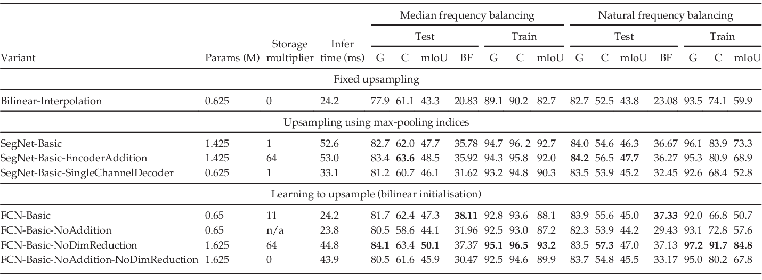
Table of comparison of decoder variants
mIoU : mean of intersection over union
BF : semantic contour measure
G : global average
C : class average

Slide 15

Analysis Summary
The best performance is achieved when encoder feature maps are stored in full. This is reflected in the semantic contour delineation metric (BF) most clearly.
When memory during inference is constrained, then compressed forms of encoder feature maps can be stored and used with an appropriate decoder to improve performance.
Larger decoders increase performance for a given encoder network.

Slide 16
Benchmarking
On CamVid and SUN RGB-D

Slide 17
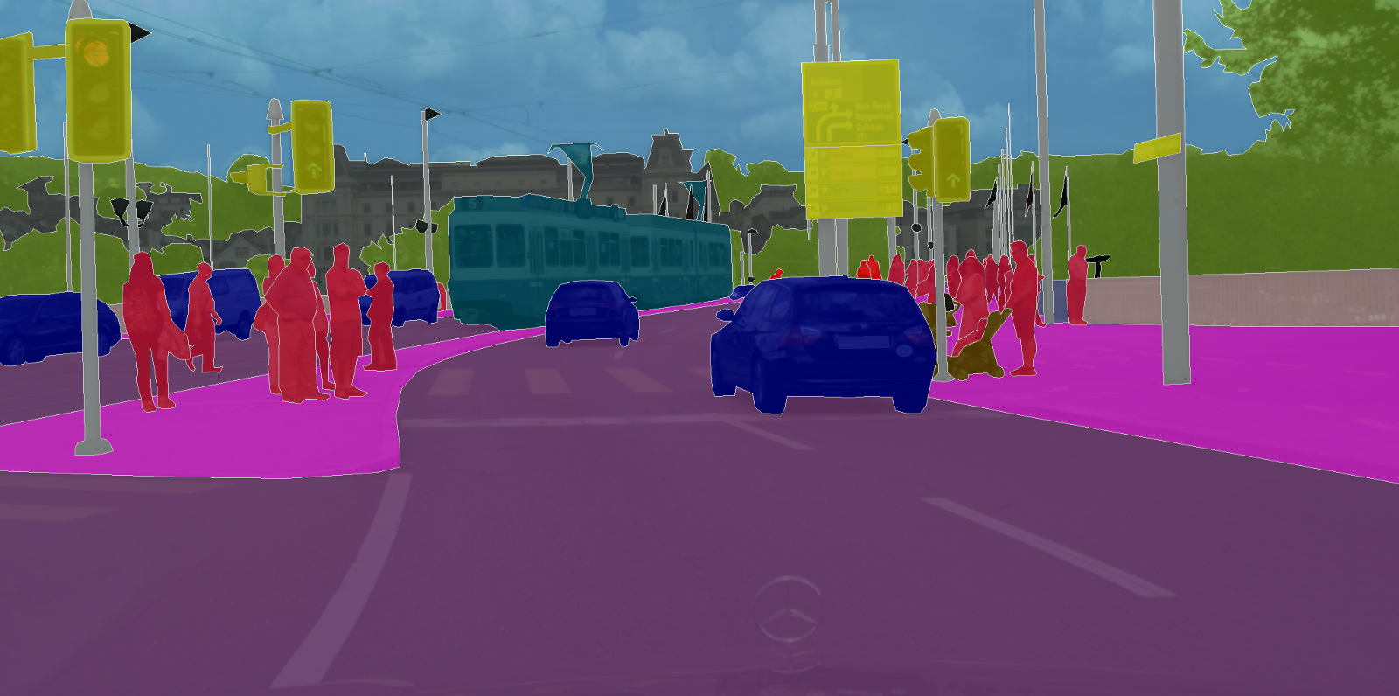
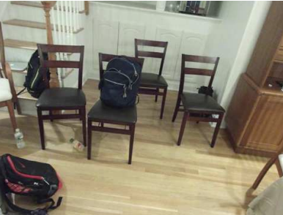
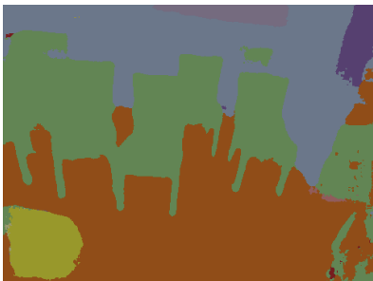
Benchmarking
We quantify the performance of SegNet on two scene segmentation benchmarks:
Road scene segmentation
Indoor scene segmentation

Slide 18
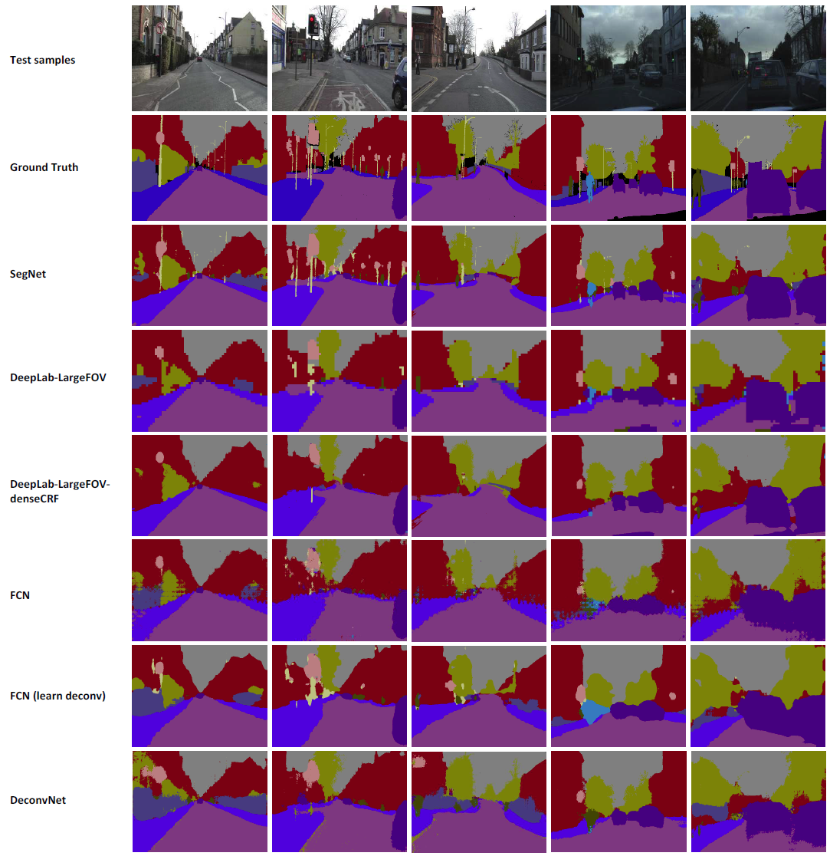
Road Scene Segmentation
SegNet
DeepLab-LargeFOV
Test samples
DeepLab-LargeFOV-denseCRF
Ground Truth
FCN
FCN
(learn deconv)
Results on CamVid day and dusk test samples
DeconvNet

Slide 19
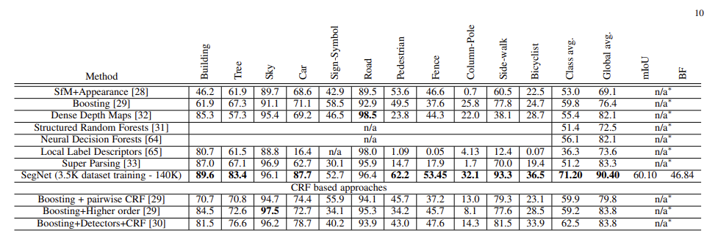
Quantitative comparisons of SegNet with traditional methods on the CamVid 11 road class segmentation problem.

Slide 20
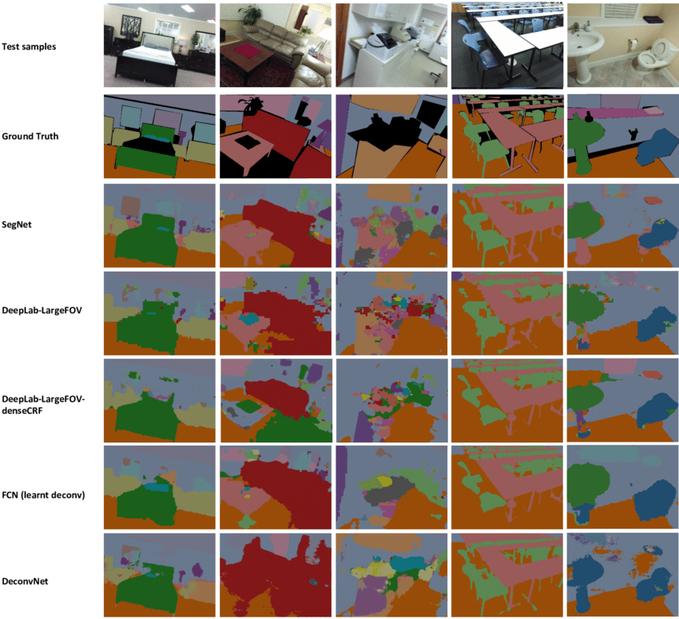
SUN RGB-D Indoor Scenes
SegNet
Test samples
DeepLab-LargeFOV
Ground Truth
DeepLab-LargeFOV-denseCRF
FCN
(learn deconv)
Qualitative assessment of SegNet predictions on RGB indoor test scenes from the recently released SUN RGB-D dataset
DeconvNet

Slide 21
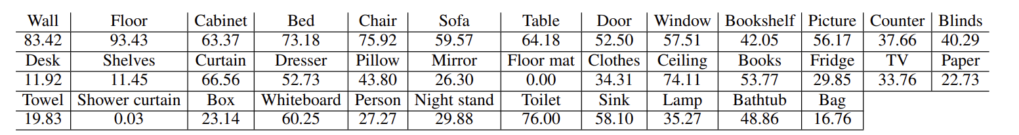
Class average accuracies of SegNet predictions for the 37 indoor scene classes in the SUN RGB-D benchmark dataset

Slide 22
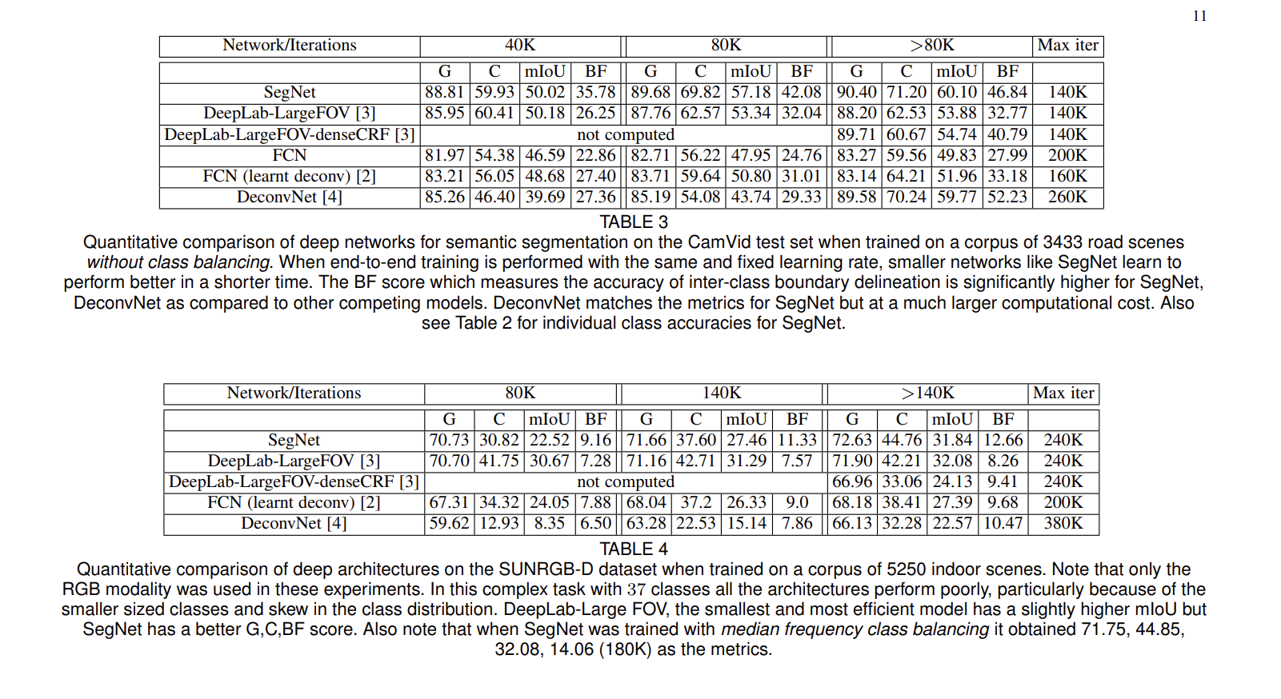
CamVid segmentation vs SUNRGB-D segmentation
Quantitative comparison of deep networks for semantic segmentation on the CamVid test set when trained on a corpus of 3433 road scenes without class balancing.
Quantitative comparison of deep architectures on the SUNRGB-D dataset when trained on a corpus of 5250 indoor scenes

Slide 23
Conclusion

Slide 24





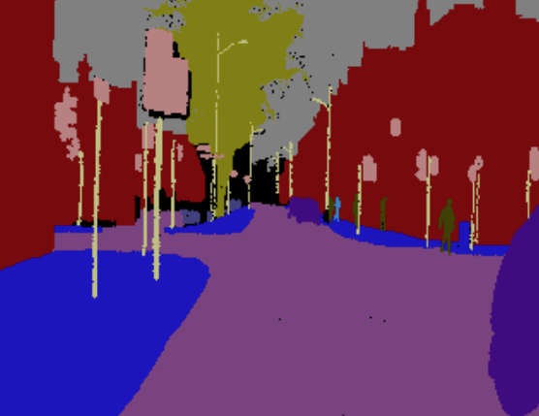
Conclusion
SegNet :
Born from the need to design an efficient architecture for road and indoor scene understanding which is efficient both in terms of memory and computational time
Stores the max-pooling indices of the feature maps and uses them in its decoder network to achieve good performance.
memory
computational time

